Slide 1
Chapter 16: Database Administration and Security: 16-6 Security

Slide 2
Learning Objectives
After completing this chapter, you will be able to:
Describe the processes and systems in the information security framework that support the three database security goals

Slide 3
Data as a Corporate Asset (1 of 3)
Data is a valuable resource that can translate into information
If the information is accurate and timely, it can enhance the company’s competitive position and generate wealth
An organization is subject to a data-information-decision cycle
Data user applies intelligence to data to produce information that is the basis of knowledge used in decision making

Slide 4
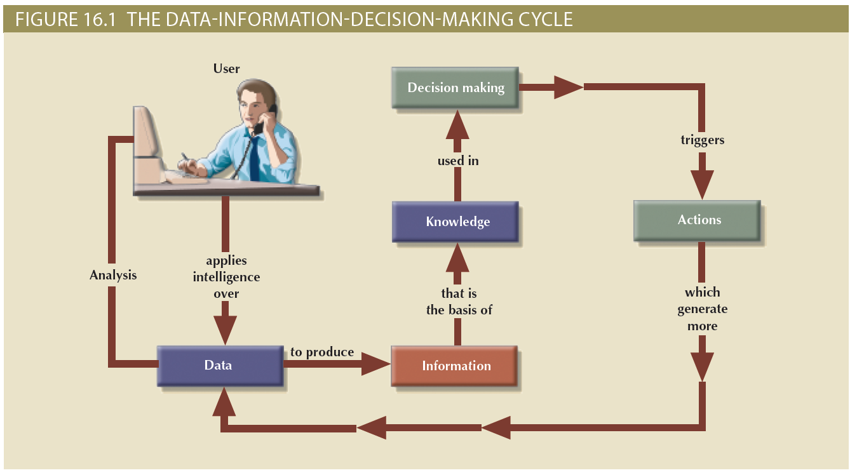
Data as a Corporate Asset (2 of 3)

Slide 5
Security
Information system security - refers to activities and measures that ensure the confidentiality, integrity, and availability of an information system and its main asset, data
Database Security Goals
Confidentiality - Protecting data against unauthorized access
Data evaluated and classified according to level of confidentiality (highly restricted, confidential, unrestricted)
Compliance - Activities that meet data privacy and security reporting guidelines
Integrity - Keeping data consistent and free of errors or anomalies
Availability - Accessibility of data whenever required by authorized users and for authorized purposes

Slide 6
Security Policies
Collection of standards, policies, and procedures created to guarantee security
Ensures auditing and compliance
Security audit process
Identifies security vulnerabilities
Finds measures to protect the system

Slide 7
Security Vulnerabilities
Weakness in a system component that could allow unauthorized access or cause service disruptions
Categories: technical, managerial, cultural, and procedural
Security threat: imminent security violation
Security breach: occurs when a security threat is exploited and could lead to a database whose integrity is preserved or corrupted
Preserved or corrupted

Slide 8
Table 16.4 Sample Security Vulnerabilities and Related Protective Measures (1 of 2)
SYSTEM COMPONENT | SECURITY VULNERABILITY | SECURITY MEASURES
People | The user sets a blank password. The password is short or includes a birth date. The user leaves the office door open all the time. The user leaves payroll information on the screen for long periods of time. | Enforce complex password policies. Use multilevel authentication. Use security screens and screen savers. Educate users about sensitive data. Install security cameras. Use automatic door locks.
Workstation and servers | The user copies data to a flash drive. The workstation is used by multiple users. A power failure crashes the computer. Unauthorized personnel can use the computer. Sensitive data is stored on a laptop computer. Data is lost due to a stolen hard disk or laptop. A natural disaster occurs. | Use group policies to restrict the use of flash drives. Assign user access rights to workstations. Install uninterrupted power supplies (UPSs). Add security locks to computers. Implement a kill switch for stolen laptops. Create and test data backup and recovery plans. Protect the system against natural disasters—use co-location strategies.
Operating system | Buffer overflow attacks Virus attacks Root kits and worm attacks Denial-of-service attacks Trojan horses Spyware applications Password crackers | Apply OS security patches and updates. Apply application server patches. Install antivirus and antispyware software. Enforce audit trails on the computers. Perform periodic system backups. Install only authorized applications. Use group policies to prevent unauthorized installations.

Slide 9
Table 16.4 Sample Security Vulnerabilities and Related Protective Measures (2 of 2)
SYSTEM COMPONENT | SECURITY VULNERABILITY | SECURITY MEASURES
Applications | Application bugs—buffer overflow SQL injection, session hijacking, etc. Application vulnerabilities—cross-site scripting, nonvalidated inputs Email attacks—spamming, phishing, etc. Social engineering emails | Test application programs extensively. Build safeguards into code. Do extensive vulnerability testing in applications. Install spam filters and antivirus software for email systems. Use secure coding techniques (see www.owasp.org). Educate users about social engineering attacks.
Network | IP spoofing Packet sniffers Hacker attacks Clear passwords on network | Install firewalls. Use virtual private networks (VPNs). Use intrusion detection systems (IDSs). Use network access control (NAC). Use network activity monitoring.
Data | Data shares are open to all users. Data can be accessed remotely. Data can be deleted from a shared resource. | Implement file system security. Implement share access security. Use access permission. Encrypt data at the file system or database level.

Slide 10
Database Security
DBMS features and related measures that comply with the security requirements
Authorization management: procedures to protect database security and integrity
User access management
View definition
DBMS access control
DBMS usage monitoring
Audit log: automatically records description of database operations performed by all users

Slide 11
Additional Database Security Safeguards
To protect the DBMS against service degradation, some security safeguards are recommended. For example:
Change default system passwords.
Change default installation paths.
Apply the latest patches.
Secure installation folders with proper access rights.
Make sure that only required services are running.
Set up auditing logs.
Set up session logging.
Require session encryption.

Slide 12
Summary (2 of 3)
Security refers to activities and measures that ensure the confidentiality, integrity, and availability of an information system and its main asset, data
A security vulnerability is a weakness in a system component that could be exploited to allow unauthorized access or service disruption

